Slide 1



Likelihood Ratios for Out-of-Distribution Detection
Ren, Jie, Peter J. Liu, Emily Fertig, Jasper Snoek, Ryan Poplin, Mark Depristo, Joshua Dillon, and Balaji Lakshminarayanan. "Likelihood ratios for out-of-distribution detection." Advances in neural information processing systems 32 (2019).
Alireza Mazochi

Slide 2
Overview
Introduction
Method
Results
Conclusion

Slide 3
Introduction

Slide 4
The Title of the Article
“Likelihood Ratios
for
Out-of-Distribution Detection”

Slide 5
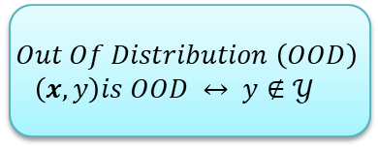
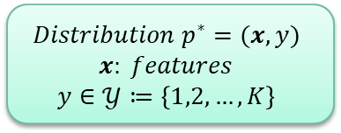
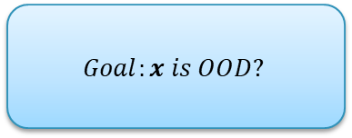
Problem Definition
$$Distribution p^{∗}=(x, y)$$
$$x: features$$
$$y∈𝒴≔\left\{1,2, …,K\right\}$$
$$Out Of Distribution \left(OOD\right)$$
$$\left(x,y\right)is OOD ↔ y∉𝒴$$
$$Goal:x is OOD?$$

Slide 6
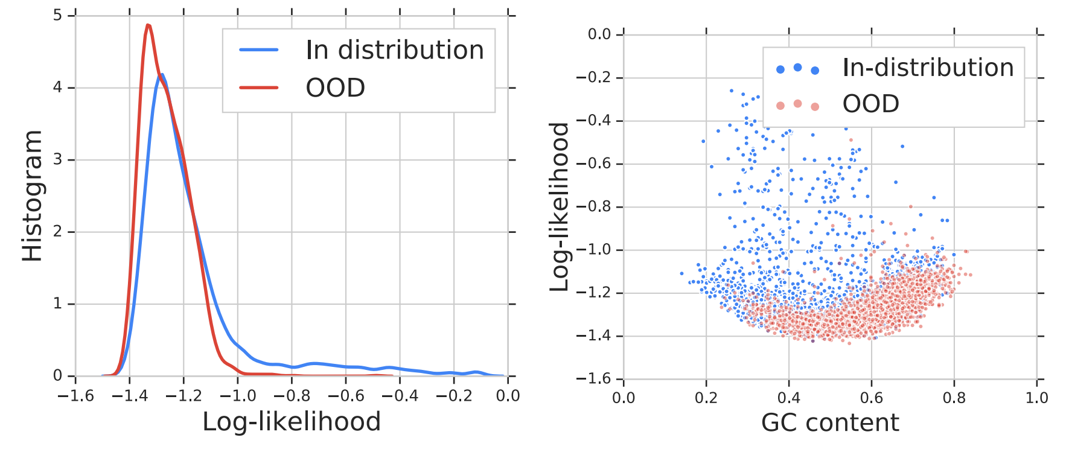
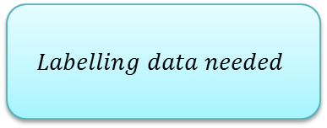
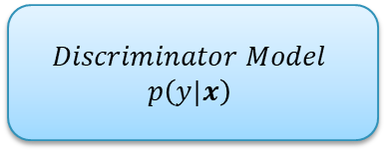
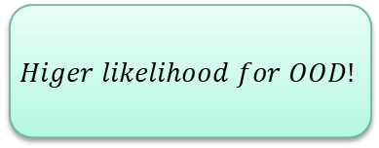
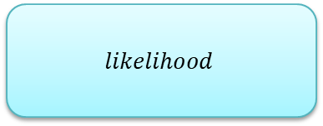
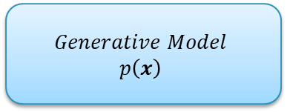
Related Works
$$Discriminator Model$$
$$p\left(y|x\right)$$
$$Generative Model$$
$$p\left(x\right)$$
$$Labelling data needed$$
$$likelihood$$
$$Higer likelihood for OOD!$$

Slide 7
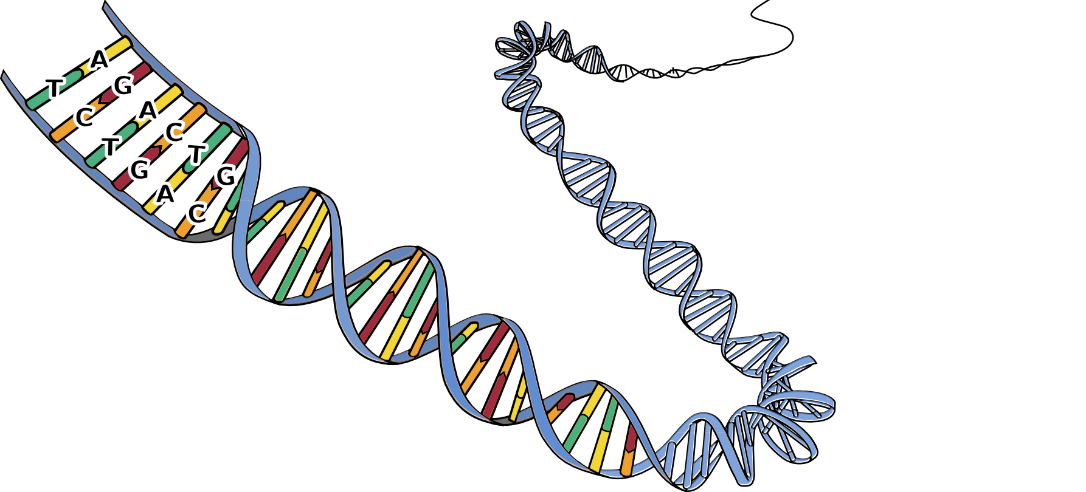
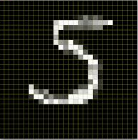
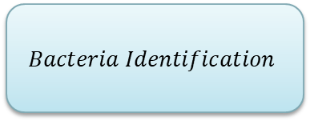
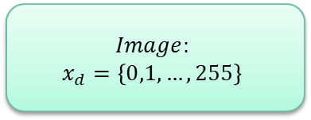
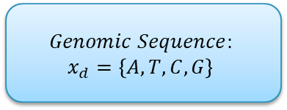
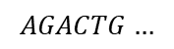
Article Domain
$$Bacteria Identification$$
$$Genomic Sequence:$$
$$x_{d}=\left\{A, T, C,G\right\}$$
$$Image:$$
$$x_{d}=\left\{0,1,…,255\right\}$$
$$AGACTG…$$

Slide 8
Method

Slide 9

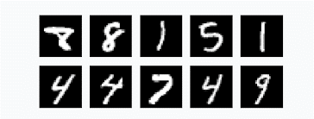
Background on Image and Text

Slide 10
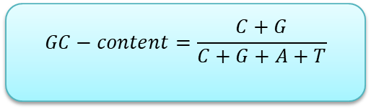
Background on Genetic
$$GC−content=\frac{C+G}{C+G+A+T}$$

Slide 11
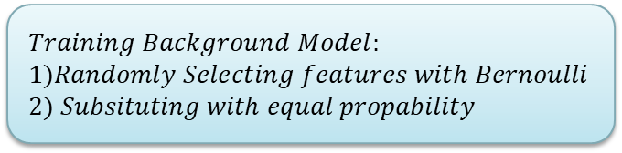
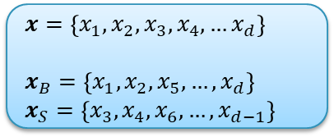
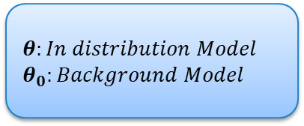
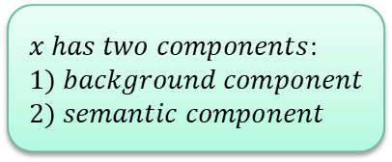
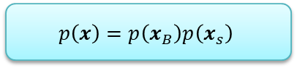
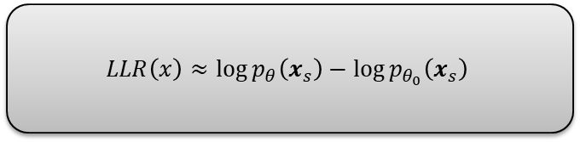
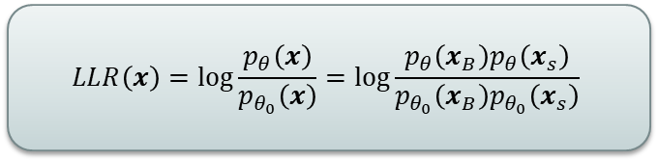
Solution
$$x has two components:$$
$$1) background component$$
$$2) semantic component$$
$$Training Background Model:$$
$$1)Randomly Selecting features with Bernoulli$$
$$2) Subsituting with equal propability$$
$$p\left(x\right)=p\left(x_{B}\right)p\left(x_{s}\right)$$
$$LLR\left(x\right)=\log{\frac{p_{θ}\left(x\right)}{p_{θ_{0}}\left(x\right)}}=\log{\frac{p_{θ}\left(x_{B}\right)p_{θ}\left(x_{s}\right)}{p_{θ_{0}}\left(x_{B}\right)p_{θ_{0}}\left(x_{s}\right)}}$$
$$x=\left\{x_{1}, x_{2}, x_{3},x_{4}, …x_{d}\right\}$$
$$x_{B}=\left\{x_{1}, x_{2}, x_{5},…, x_{d}\right\}$$
$$x_{S}=\left\{x_{3},x_{4}, x_{6},…,x_{d−1}\right\}$$
$$LLR\left(x\right)≈\log{p_{θ}\left(x_{s}\right)}−\log{p_{θ_{0}}\left(x_{s}\right)}$$
$$θ:In distribution Model$$
$$θ_{0}:Background Model$$

Slide 12
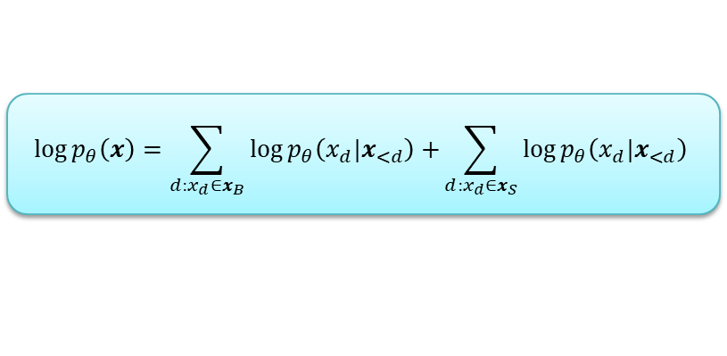
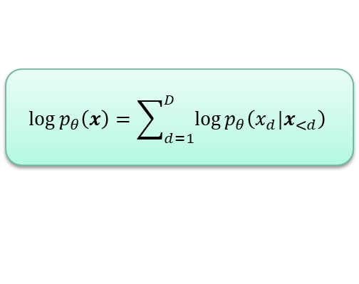
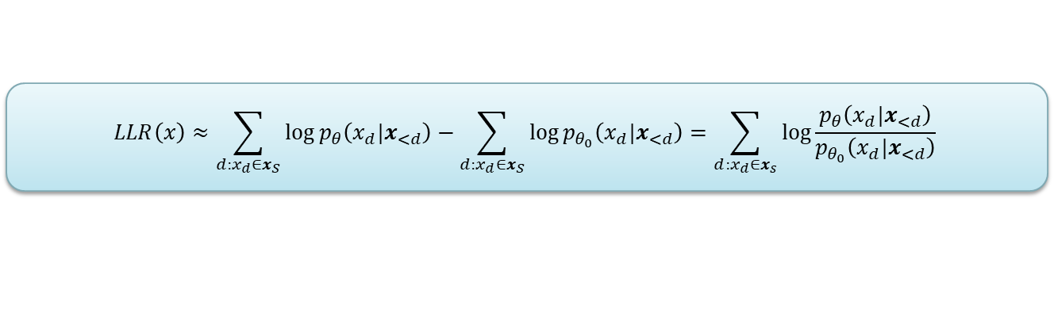
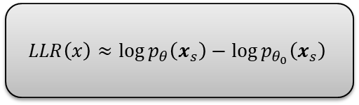
Autoregressive Model
$$\log{p_{θ}\left(x\right)}=\sum_{d=1}^{D}{\log{p_{θ}\left(x_{d}|x_{<d}\right)}}$$
$$\log{p_{θ}\left(x\right)}=\sum_{d:x_{d}∈x_{B}}{\log{p_{θ}\left(x_{d}|x_{<d}\right)}+}\sum_{d:x_{d}∈x_{S}}{\log{p_{θ}\left(x_{d}|x_{<d}\right)}}$$
$$LLR\left(x\right)≈\log{p_{θ}\left(x_{s}\right)}−\log{p_{θ_{0}}\left(x_{s}\right)}$$
$$LLR\left(x\right)≈\sum_{d:x_{d}∈x_{S}}{\log{p_{θ}\left(x_{d}|x_{<d}\right)}}−\sum_{d:x_{d}∈x_{S}}{\log{p_{θ_{0}}\left(x_{d}|x_{<d}\right)}}=\sum_{d:x_{d}∈x_{s}}{\log{\frac{p_{θ}\left(x_{d}|x_{<d}\right)}{p_{θ_{0}}\left(x_{d}|x_{<d}\right)}}}$$

Slide 13
Results

Slide 14
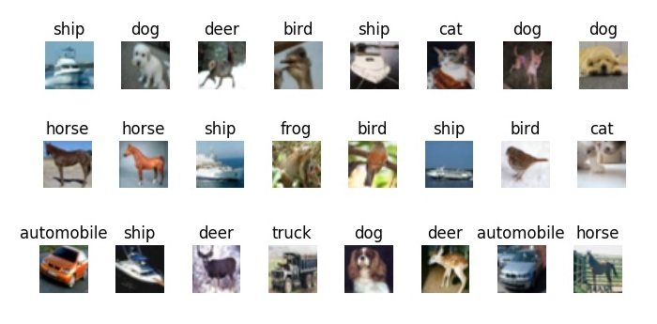
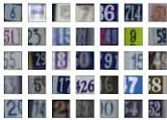
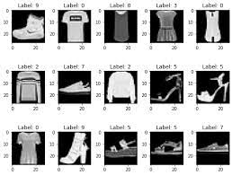
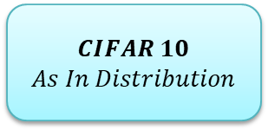
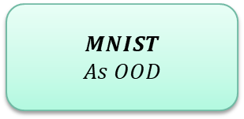
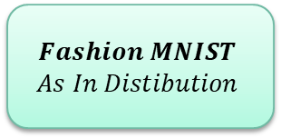
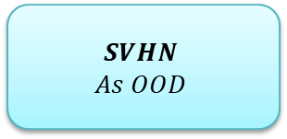
Images Datasets
$$Fashion MNIST$$
$$As In Distibution$$
$$MNIST$$
$$As OOD$$
$$CIFAR 10$$
$$As In Distribution$$
$$SVHN$$
$$As OOD$$

Slide 15
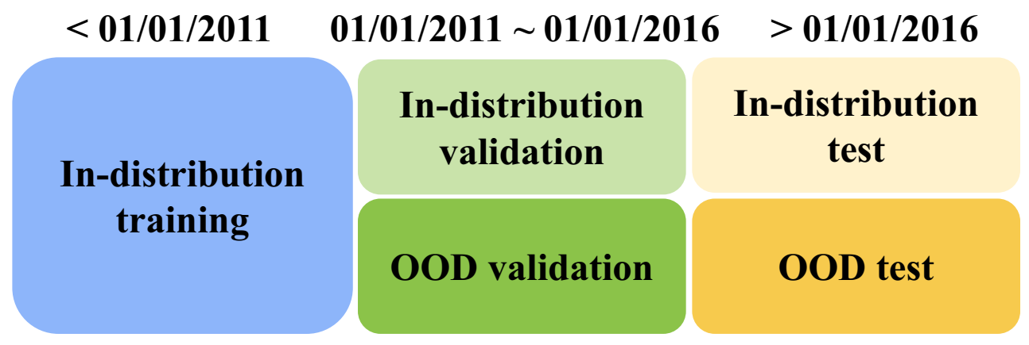
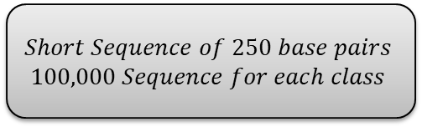
Genomic Sequence Dataset
$$Short Sequence of 250 base pairs$$
$$100,000 Sequence for each class$$
ID: 10 Classes
Test OOD: 60 Classes
Validation OOD: 60 Classes

Slide 16
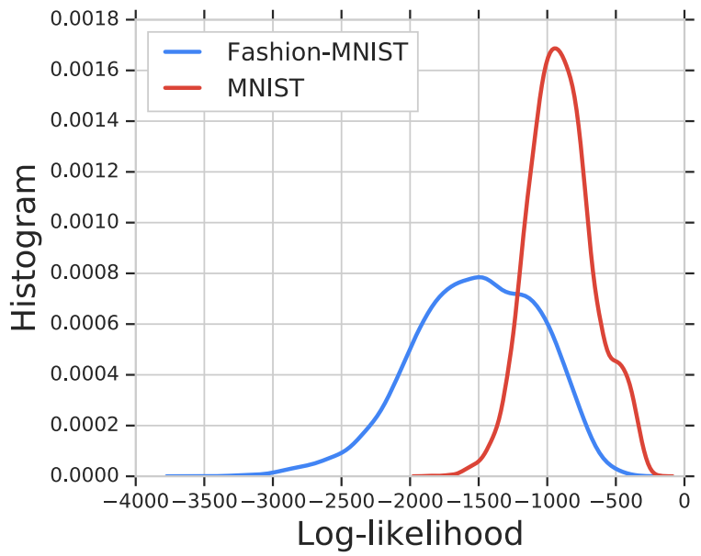
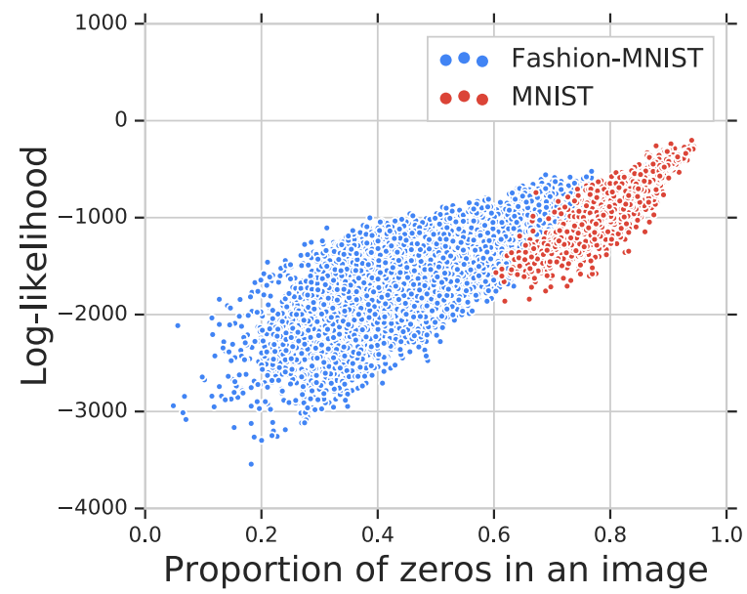
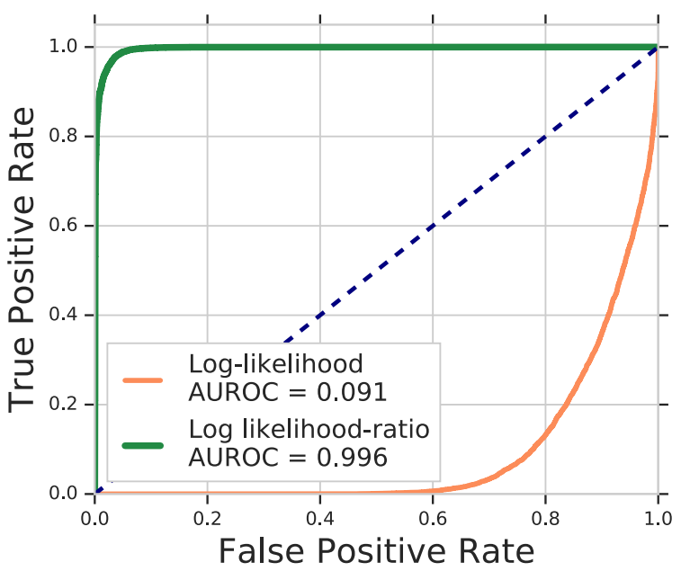
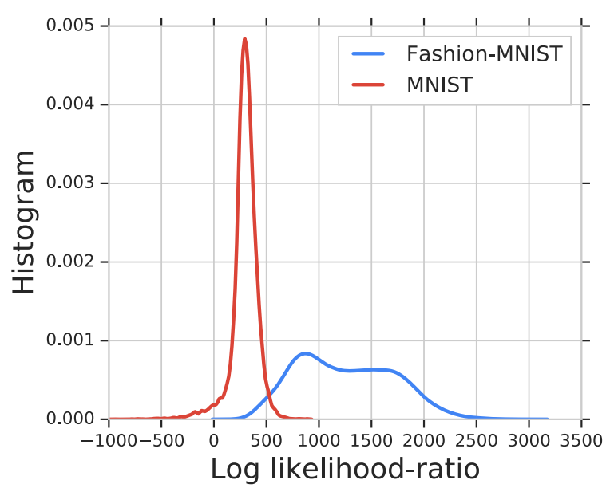
Images

Slide 17
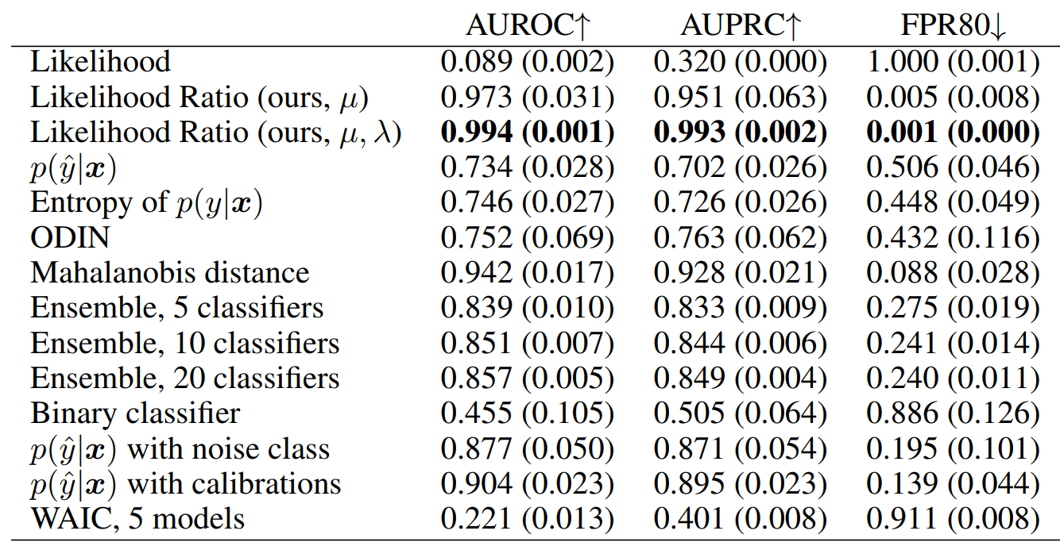
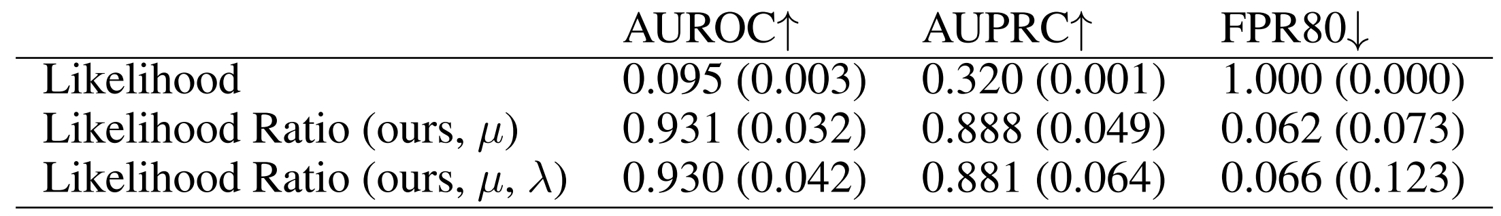
Images
Fashion MNIST
&
MNIST
SVHN
&
CIFAR 10

Slide 18
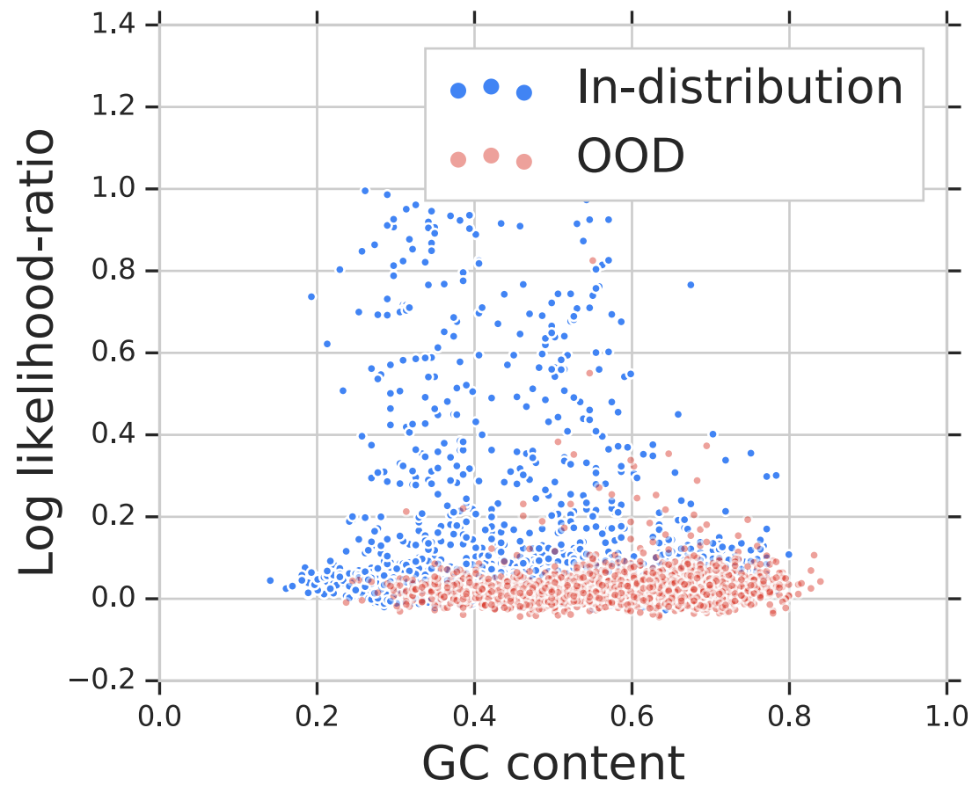
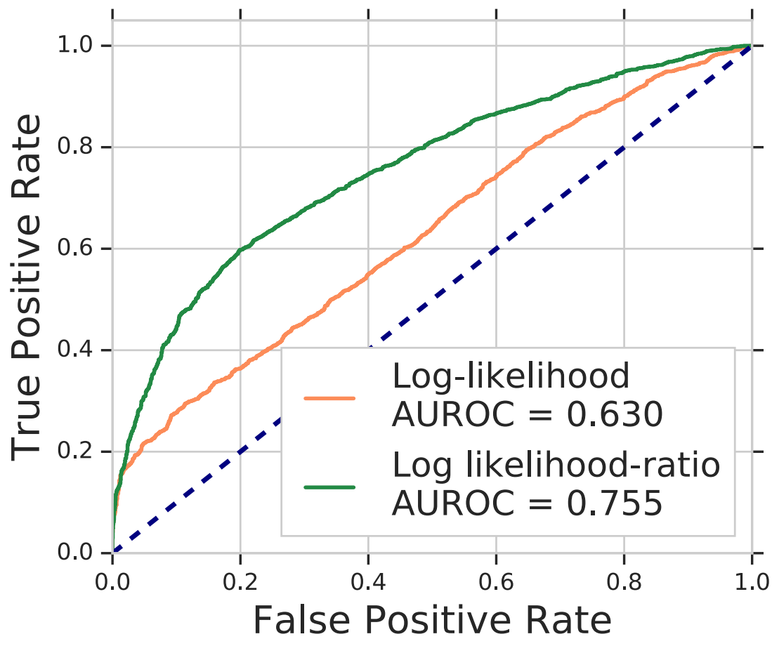
Genomic

Slide 19
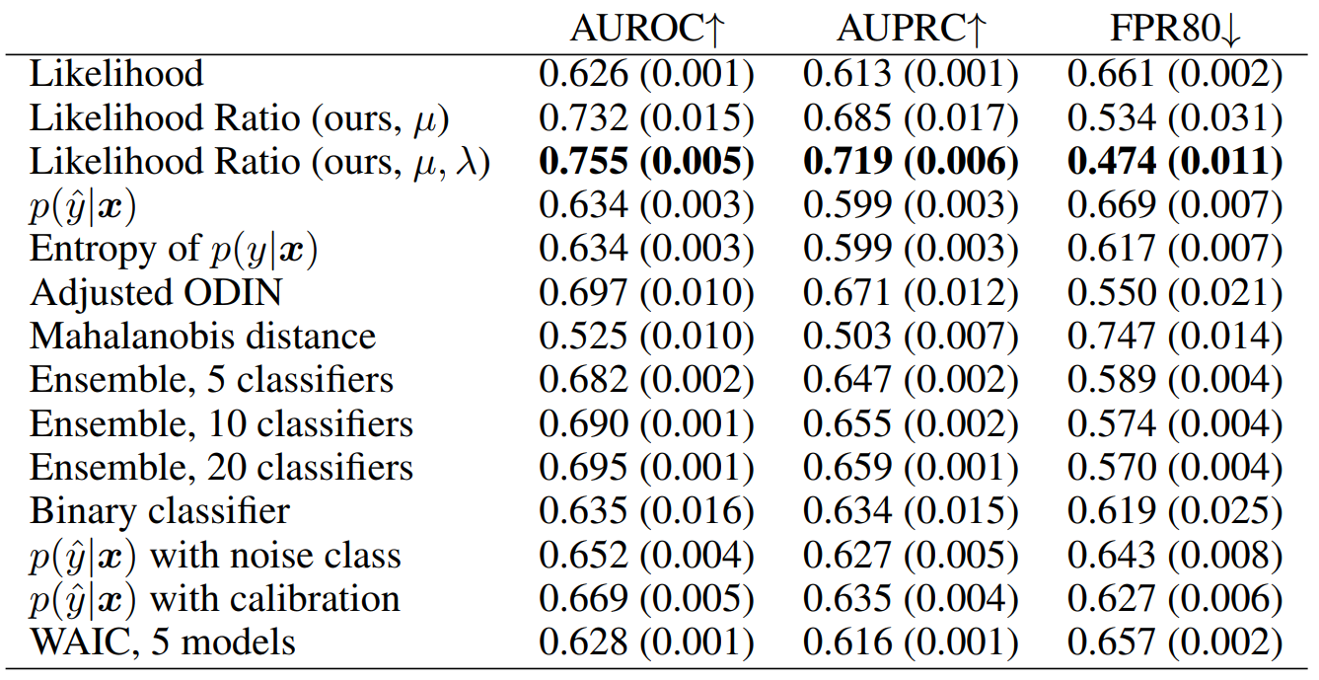
Genomic

Slide 20
Conclusion

Slide 21
Pros and Cons
Pros
Cons
Relatively few results
Code availability
Simple Idea
Creation Dataset
Multi-Modality

Slide 22
Future works
Other modalities like texts
Improve the results on the Genomic dataset
Test Other data thresholds on the Genomic dataset

Slide 23
References
[1] Ren, Jie, Peter J. Liu, Emily Fertig, Jasper Snoek, Ryan Poplin, Mark Depristo, Joshua Dillon, and Balaji Lakshminarayanan. "Likelihood ratios for out-of-distribution detection." Advances in neural information processing systems 32 (2019).

Slide 24
Thanks For Attention!

